Slide 1

INTRODUCTION TO GOODS & SERVICES TAX
PRESENTED BY
Dr. A. MEHATHAB SHERIFF, M.Com., M.Phil., Ph.D., PGDHRM., NET, SET,
Associate Professor of Commerce (SF),
Jamal Mohamed College, Trichy

Slide 2
Taxation in India
DIRECT TAXES
INCOME TAX
INDIRECT TAXES
EXCISE DUTY
CUSTOMS DUTY
WEALTH TAX
CENTRAL SALES TAX
OCTROI
VAT

Slide 3
Indirect Taxation
In 2005 - VAT (Value Added Tax)
- A Reform to improvise and streamline
the Indirect Tax System in India.
- An initiative to Reduce the Cascading Effect of Taxation.
- A method to systematise the Input Tax Credit (ITC)

Slide 4
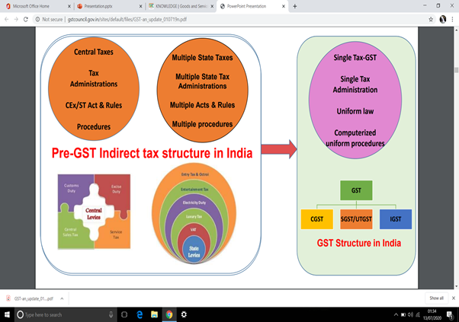

Slide 5
GST – AN OVERVIEW
- GST is a single uniform indirect tax which was introduced to replace Central and State indirect taxes such as VAT, CENVAT, and others.
- GST applies on all types of businesses, small or large. This makes it one of the greatest tax reforms in the country. The entire nation will follow a unified tax structure.

Slide 6
GST – AN OVERVIEW
- GST is applicable on both goods and services and India will follow a dual system of GST to keep both the Centre and State independent of each other.
- GST has been devised as a four-tiered tax structure with tax slabs of 5%, 12%, 18%, and 28% for various different categories of products and services. 0% rate is kept for most essential goods such as rice, wheat.

Slide 7
THANK YOU

